Slide 1

Weekly report <E-bill>
Naveen, Programmer
06.05.2021

Slide 2
Email confirmation for Log in
New activity added in application
Code for checking correct Email id and Password
No Fake log in
Added userlogin() method

Slide 3
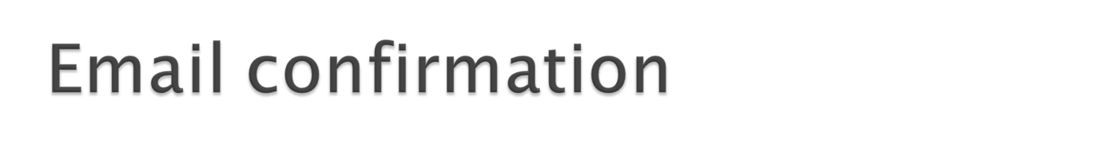
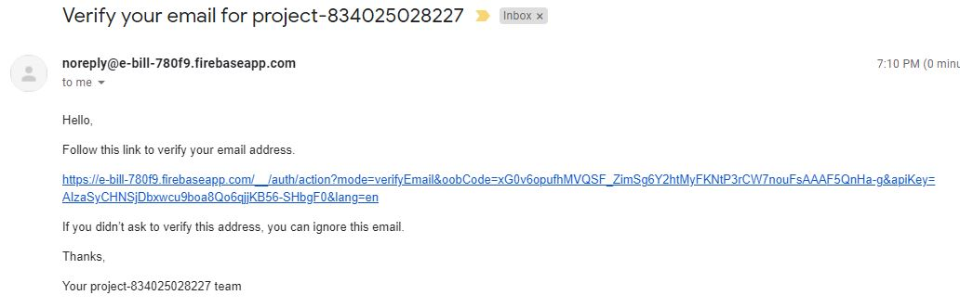
When user login with his email id and password he/she will get mail for verification .

Slide 4

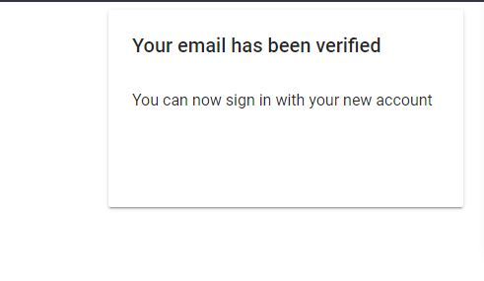

Slide 5
Using Email
Vk
Using Whatsapp with team members

Slide 6
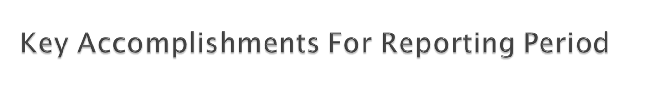
Kick off meeting
WBS
PMP
STP
Metrics
Configuration Management
Test
Design Main activity and Registration activity

Slide 7
Past Accomplishments | Plan | Actual
<Task/Milestone> | DD-MM-YYYY | DD-MM-YYYY
Kick of Meeting | 04-03-21 | 27-02-21
SOW | 04-03-21 | 27-02-21
PMP | 18-03-21 | 24-03-21
Authentication ,Registration | 14-04-21 | 14-04-21
Real time Database | 22-04-21 | 22-04-21
Email Verification | 07-05-21 | 06-05-21
Future Milestones | % | Plan | Forecast
<Task/Milestone> | <n>% | DD-MM-YYYY | DD-MM-YYYY
Getting bill format , Delivery confirmation | 20 | 26-05-21 | 25-05-21
Notes:
Provide milestone tracking data in your own form used in project.
Use proposed table in case you have no special form for milestone tracking

Slide 8
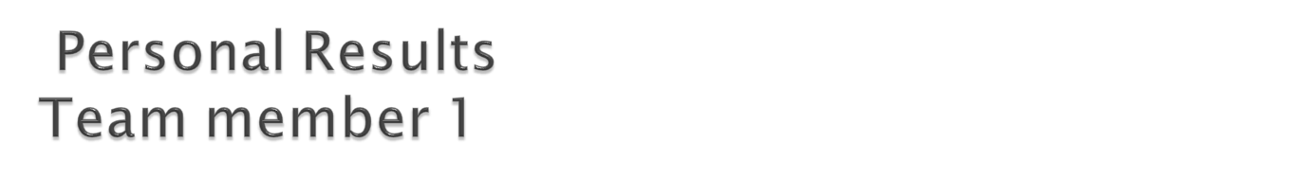
NAVEEN
Completed design of main activity and register activity for the Delivery boy
Coding for 2 activities in java
XML design for 2 activities
Email verification
Userlogin method
Checked correct mail id format
Authentication

Slide 9
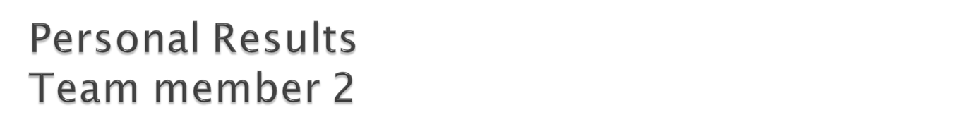
Chubchik Alexander
Testing of application
Debug reports

Slide 10
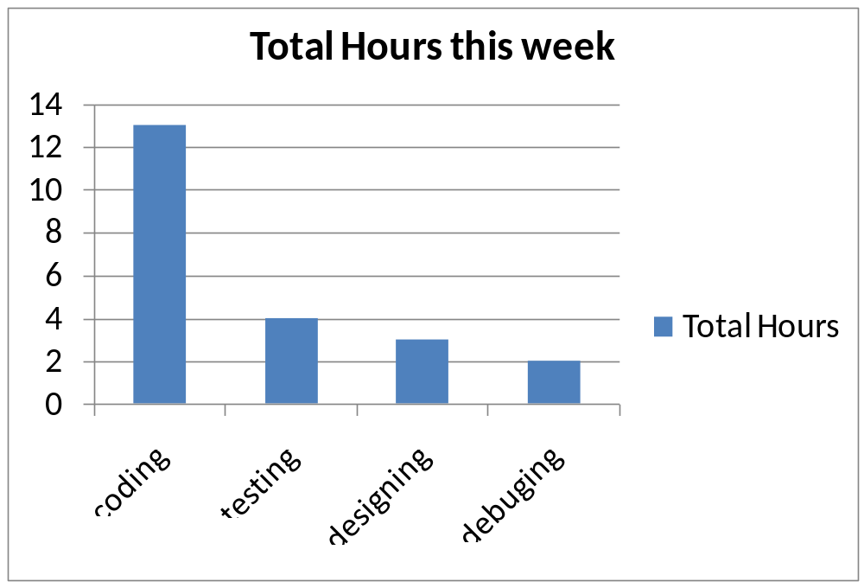

Slide 11
Add e-bill page design
Delivery Confirmation

